Slide 1
Team Treasurer
2022
Presented by: Craig Lynk
VP Finance, BDMHA
November 10, 2022

Slide 2
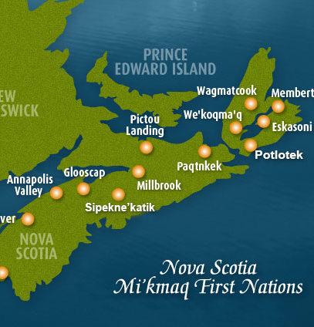
Land Acknowledgement
I would like to begin by acknowledging that we are in Mi’kma’ki, the ancestral and unceded territory of the Mi’kmaq People. HRM 4Pad sits in Kjipuktuk on the Traditional Territory of the Mi’kmaq. We are all Treaty people.

Slide 3
Accounts
Scotiabank (Millcove)
To open accounts:
Email Craig Lynk
Need a letter from BDMHA
E-Transfer payments are encouraged over cheques
Need Treasurer/Two signing authorities
Submit Budget
Beginning of Year (December 1)
End of Year
Team Finances

Slide 4
Fundraising Guidelines
U15 AA, and U18 teams (parent coach) $19,500
U15 AA, and U18 teams (non-parent coach) $21,500
All other teams, coach has a child on team $16,500
All other teams, coach no child on team $18,500
Peewee AAA $25,000
Team Expenses have two categories
Expenditures in support of approved team activities may be sourced from fundraised revenues
All purchases of a personal nature must be sourced by parent contributions
Team Fundraising

Slide 5
Category 1 - Fundraised Money Approved Expenditures
Team Tournament entrance registration fees
The cost of hotel/motel rooms (per pair of coaches) for nonparent coaches
The cost of gas and/or tolls for the non-parent coach to attend an away Tournament/games.
The cost of meals to a maximum of $40/day, excluding any alcohol, for the non-parent coaching staff at an away tournament.
Ice costs - both billed by the BDMHA and any other used by the team for development or exhibition games.
Timekeepers & referee fees not covered by the Association
Reasonable team equipment items, e.g. pylons, pucks, first aid kits
Hockey socks that conform to the Association’s approved uniform guidelines.
Expenses required for fundraising activities e.g. 50/50 home game tickets, auctioneer fee, banner printing costs.
Jersey name bars.
Water bottles.
Year end event (maximum $1,000 from fundraised money)
Expense Categories

Slide 6
Category 2 – Parent Funds
Clothing items such as jackets, hoodies, track suits etc.
Pant shells
Helmet stickers
Trophies/prizes
Team parties (outside of the $1,000 limit for year end party)
Parent and team travel costs including transportation, hotels, meals etc.
Expense Categories

Slide 7
Questions

