Slide 1
Team Safety Rep
2022
Presented by: Lori Connors
Safety Coordinator, BDMHA
November 10, 2022

Slide 2
Land Acknowledgement
I would like to begin by acknowledging that we are in Mi’kma’ki, the ancestral and unceded territory of the Mi’kmaq People. HRM 4Pad sits in Kjipuktuk on the Traditional Territory of the Mi’kmaq. We are all Treaty people.

Slide 3
Overview
Safety Rep role for 2022-2023
Dressing Room Supervision (Two-Deep Rule)
COVID
Safety Coordinator Role

Slide 4
Safety Rep Role
Ensure BDMHA Dressing Room Supervision Policy is enforced
Deal with any COVID related issues if they arise
Liaise with parents, team managers, coaches about safety issues
Liaise with Safety Coordinator re safety issues

Slide 5
Safety Coordinator
Oversee rollout of Dressing Room Supervision Policy
Communicate with team safety reps re safety issues
Communicate with head coaches, team managers re safety issues
Liaise with HNS (Member of Safe Sport Committee)
Liaise with BDMHA Exec re safety issues
Covid issues if they arise
Manage injury reports as required

Slide 6
Dressing Room Supervision Policy (HNS)
Intent is to protect players from bullying, harassment and abuse
Supervision required before, during and after all games and practices
“Two Deep Method”
A lone personnel member should never be in the dressing room with players at any time, especially when players are showering or changing: two adults should be present together
Supervising personnel must be members of the team staff or adults who have completed either “Speak Out” or the “Respect In Sport” for volunteers and have submitted their record checks [VSC & CRC] to their MHA
Parents of all players should be made aware of the “Two Deep Method” and avoid letting their children into unsupervised dressing rooms.

Slide 7
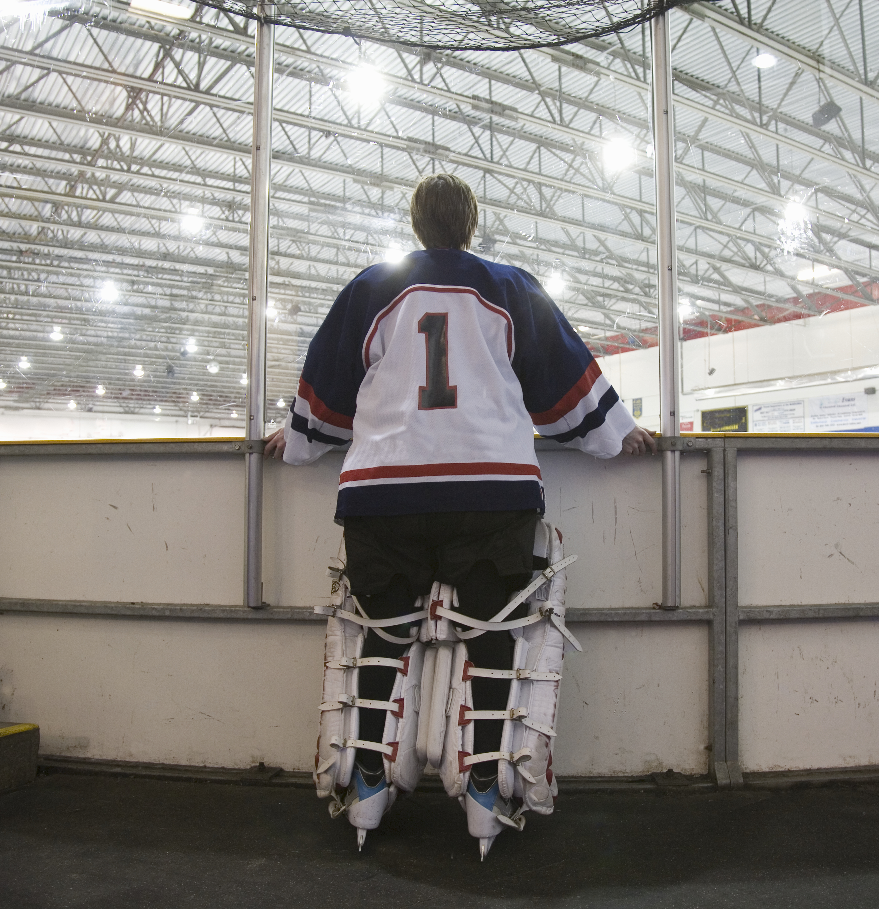
Proposed BDMHA Dressing Room Supervision Policy
Two coaches and/or team manager/safety with current criminal record check and vulnerable sector check
If a team requires additional parent volunteers to aid in the Two Deep Method those volunteers must:
Complete “Respect In Sport” modules
Submitted their record checks [Vulnerable sector and Criminal Record] to certifications@bedfordblues.com
Cost of $100 for a team to add an additional 4 volunteers (credentialing cost)

Slide 8
Proposed BDMHA Dressing Room Supervision Policy
Failure to comply with this policy will mean:
1st offense, no penalty but a written warning to the coaches and support staff
2nd offense, 1 game suspension of head coach
3rd offense, 3 game suspension of head coach
4th offense, 5 game suspension of head coach
5th offense, removed from the roster for the remainder of the season, including playoffs.

Slide 9
Independent Third-Party Investigations
The role of the independent third party is to:
Receive all hockey related maltreatment, sexual violence, harassment, abuse or discrimination complaints by someone affiliated with Hockey Canada;
Analyze complaints in light of Hockey Canada and Member policies and determine how they are to be managed and the proper jurisdiction;
Where applicable, ensure matters are properly reported to law enforcement or child protection services;
Retain investigators and dispute resolution panels who are also independent of Hockey Canada;
Work with Canada's Office of the Sport Integrity Commissioner and the Member associations to ensure no gaps in complaint coverage and that all complaints are handled in accordance with applicable policies and that decisions are documented in writing.

Slide 10
Reporting Abuse or Harassment is often a difficult process. The Independent Third Party is committed to operating in a trauma informed manner. For example:
All reports will be kept entirely confidential, in line with the wishes of the person making the complaint. This includes confidentiality from Hockey Canada and Member association staff.
All Complaints will be followed up in a timely manner. The Independent Third Party has developed resources to share with survivors of abuse and can direct survivors to additional supports.
The Independent Third-Party answers questions about the complaint process.
Complaints are taken seriously and rigorously examined.
The Independent Third Party is staffed by a number of diverse professionals reflecting both gender and racial diversity. Service is available in both French and English.
Independent Third-Party Investigations
Complaints can be submitted by email to complaints@sportcomplaints.ca

Slide 11
Questions

