Slide 1
Team Manager
2022
Presented by: Jennifer MacLeod
Secretary, BDMHA
November 10, 2022

Slide 2
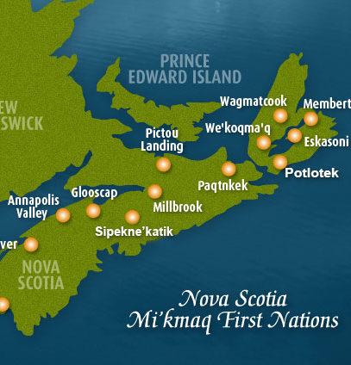
Land Acknowledgement
I would like to begin by acknowledging that we are in Mi’kma’ki, the ancestral and unceded territory of the Mi’kmaq People and we acknowledge them as the past, present, and future caretakers of this land. HRM 4Pad sits in Kjipuktuk on the Traditional Territory of the Mi’kmaq. We are all Treaty people.

Slide 3
Key point of contact for the team
Booking Tournaments
Identify Team Leads
Certifications
Forms
GrayJay/TeamLinkt
Booking ice (AAA, AA, A and B only)
Exhibition games
Parent Meeting
Team events
Jersey Tracking
Team merchandise – Nova Trophy
Call Ups
Injury reporting
League Information
Key Information

Slide 4
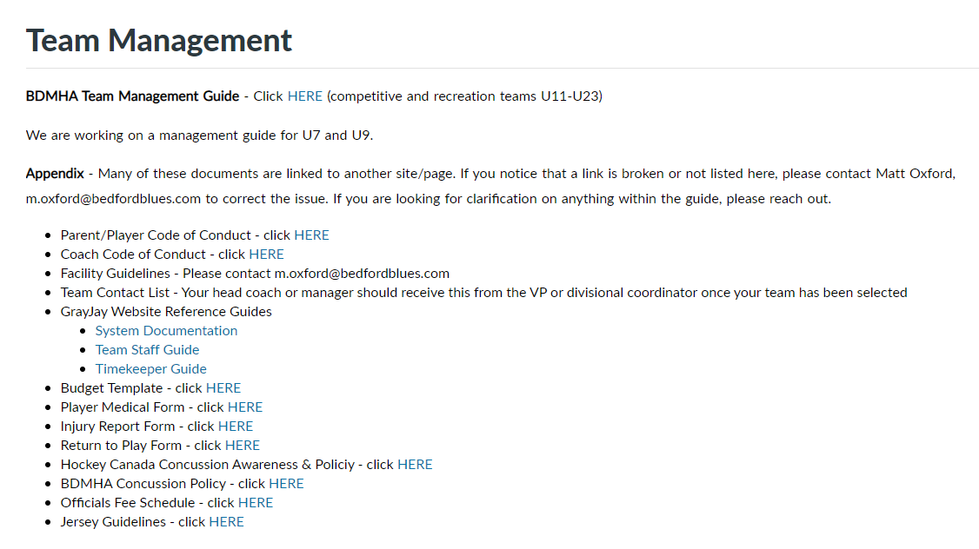
Team Management Guide
https://bedfordblues.com/l/31/BDMHA/pages/3358/Team-Management/
Team Management

Slide 5
As the primary point of contact for the team, the Manager will be the interface between the coaches and the parents/players.
Key areas of communication for the Manager:
The Association will push communication to the Manager either directly or via the Divisional Coordinator
Contact info for all players can be sourced from Matt Oxford
Weekly parent updates
TeamLinkt Lead
Contact and Communication

Slide 6
The Manager will want to book tournaments as early as possible.
Many tournaments can be found on:
www.bedfordblues.com
www.hockeynovascotia.ca
www.hnb.ca
www.hockeypei.com
Popular tournaments are :
TASA Fall Classic (AA, A, B)
Ossie Fraser (AA)
Early Bird (Sherwood, PEI)
Moncton Challenge Cup (AA, A, B)
Kyle Henneberry (B, C)
Jack Frost
Noah Llewellyn
Moncton Lounsbury (C)
Summerside
Spud (Charlottetown)
Pownal (PEI)
Joe Lamontaigne (AAA, AA, A, B)
Travel permits (U11 limited to 2 out of province)
Hotel room blocks (book a parent room)
Team meals
Tournaments

Slide 7
The Manager will need a support team of other parent volunteers to assist with the smooth running of the team.
Safety (Two-deep rule/Covid)
Time-Keeper/Score Keeper
Some associations provide these services, but Bedford managers are required to source them for home games
Treasurer (AAA, AA, A and B)
Fundraising (AAA, AA, A and B)
Team Leads

Slide 8
The Manager will work with the coaching staff and safety to ensure that appropriate certifications are in place.
https://bedfordblues.com/l/31/BDMHA/pages/1680/Volunteer-Certifications/
Ensure your HCR 3.0 (Spordle) account is setup so that certifications can be tracked. The manager works with the BDMHA Certifications Coordinator to ensure we are compliant with Hockey Nova Scotia coach and Volunteer Requirements.
https://5647e90c-cdn.agilitycms.cloud/Volunteer_Requirements-2022.pdf
Certifications

Slide 9
The Manager will send out forms to be completed and will gather and hold on to the forms for the season.
Code of Conduct (Parents/Players; Coaches)
Medical Forms
Forms

Slide 10
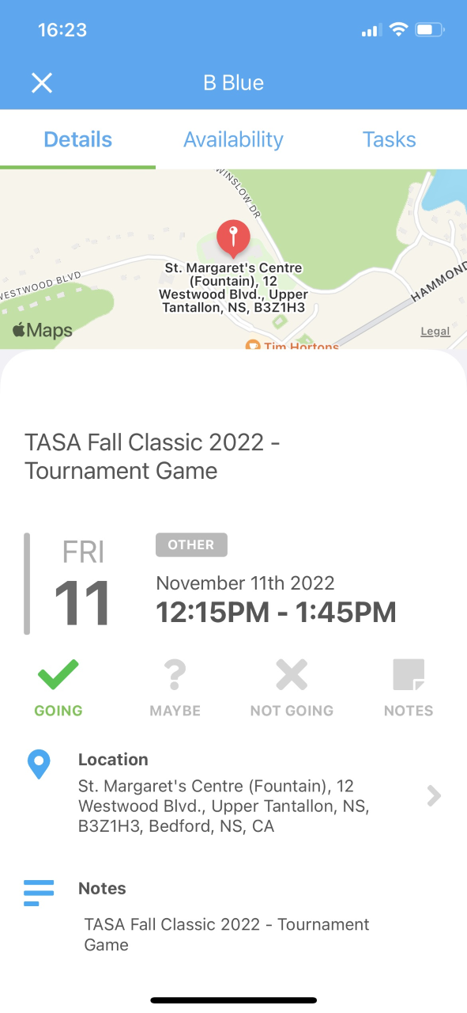
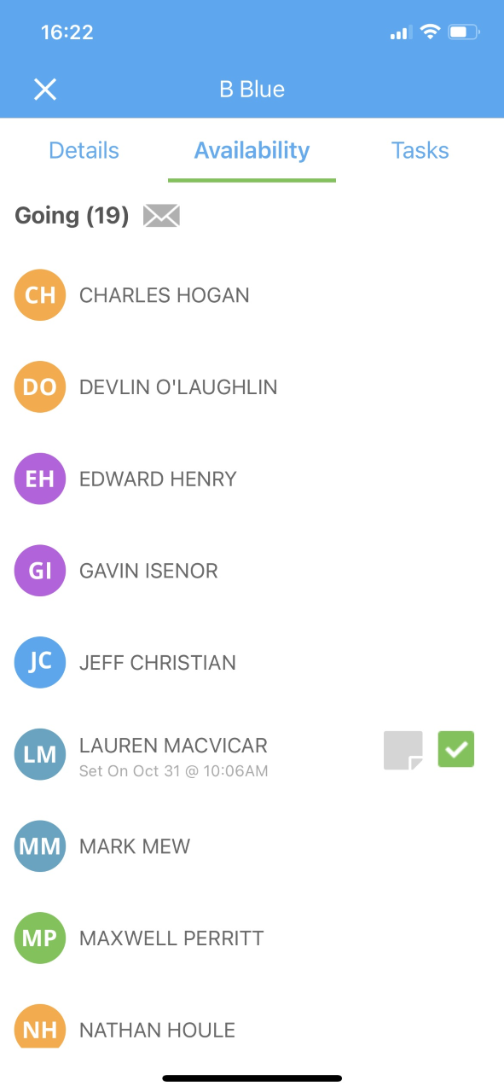
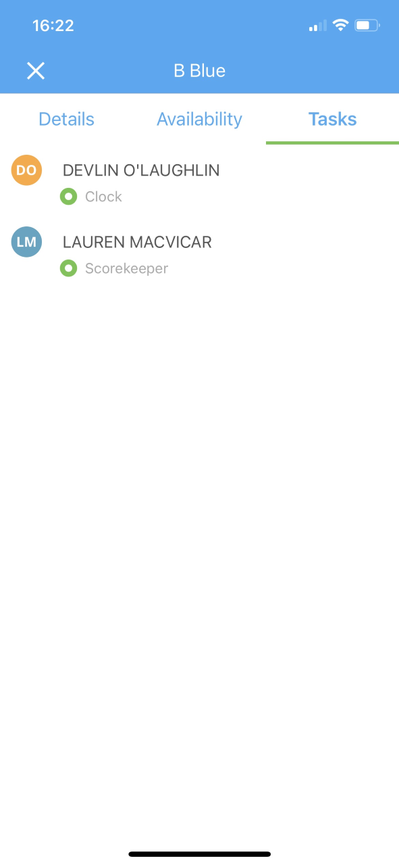
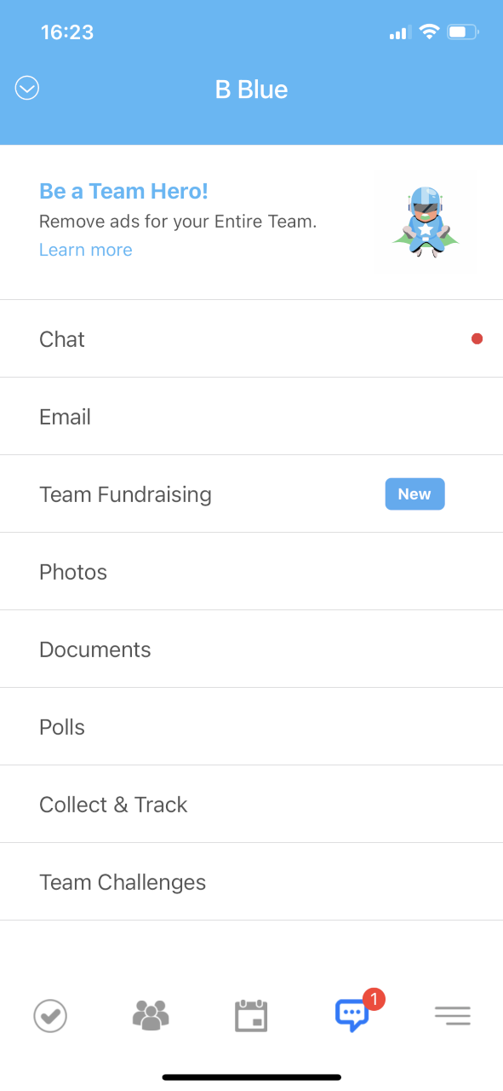
Game sheets are entered electronically into GrayJay. Managers should have a couple of paper gamesheets on hand in the event that GrayJay doesn’t work. These are available from Matt Oxford.
TeamLinkt is the primary form of communication for families. It includes scheduling, maps, availability, task assignment, chat, fund collection tracking, polls and more.
GrayJay / TeamLinkt

Slide 11
For competitive teams, there is an expectation that the manager will secure additional ice time for the team. The manager will be required to pay the facility directly for the ice time.
C teams may look to book extra ice for practices or exhibition games as well.
Ice time is at a premium in Halifax and prime time ice is very difficult to get.
Ice booking resources:
HRM Arenas
East Hants Sportsplex
West Hants Sportsplex
SMU, Shearwater and East Coast Varsity are other options, but they do not have a website.
Booking Ice

Slide 12
Many teams like to set up Exhibition Games to play teams they wouldn’t play in league or tournament play.
Book ice (or use existing practice ice)
Confirm and pay referees per the pay schedule
Obtain game permit (local) or travel permit through HCR 3.0
Exhibition Games

Slide 13
The Manager will setup a Parent Meeting early in the season, ideally in the first week.
Suggested agenda:
Introductions
Coach speaks to their philosophy and plan for the season; expectations of the player/family; dress code
Communication approach
24 hour rule
Parents to communicate with Manager not the coach
Identify team bonding events
Charitable/community event
Parent get together
Year End Party
Budget
Fundraising objective (AAA, AA, A, B)
Tournaments (how many and where)
Call for team leads
Hand out forms and deadline for return
Team merchandise
Parent Meeting

Slide 14
The Manager will setup events throughout the season.
It’s a great idea to host some or all of the following:
Charitable/community event
The VP Development can help
Parent party
Find someone to host so that parents can come together
Parent room at tournaments is a great help as well
Year-end party
Look for a way to celebrate the end of the season with the players, Coaches and volunteers
Team Events

Slide 15
The Manager distributes the jerseys at the start of the season. Replacement jerseys are very expensive so we count on the manager to track which numbers were given to each player so that we can track them on return as well. There is a tracking form to help.
Players are expected to bring their jerseys to games on hangers and in a garment or protective bag. They should not be thrown into their bags.
Jerseys are NOT to be worn at practices.
atoMc teams will receive full set of home and away jerseys and socks.
Jerseys

Slide 16
All Team Merchandise should be purchased through Nova Trophy.
Each player is required to use a standardized name bar that should be sewn above the stop sign. New name bars take 5-6 weeks to come in, so they should be ordered ASAP.
Competitive players are to have a pair of both home and away socks. C teams are required to choose one or the other as a team.
We do have an online store and host at least one Blueswear Day each season. Apparel orders take about 4-5 weeks to come in.
Team Merchandise

Slide 17
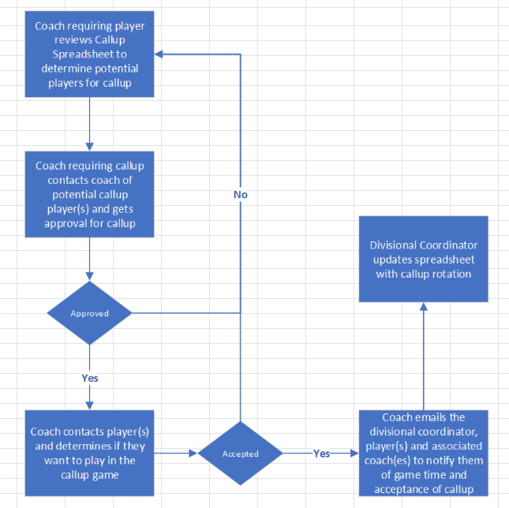
Coaches drive the call-up process, but managers should be aware of the format in case they are called on to assist.
Call Ups

Slide 18
Hockey is a physical sport and incidents can occur that result in injury.
Anytime an injury occurs, the manager is required to complete a Hockey Canada Injury Report which gets submitted to Hockey Nova Scotia. Any injury that required medical attention requires that return to play protocols are adhered to including the Return to Play form signed by a physician.
Hockey Nova Scotia has a strict concussion policy and all coaches and managers must adhere to the policy.
Injury Reporting

Slide 19
League information including schedules and game results can be found at :
https://centralminorhockey.ca/
https://metrominorhockey.ca/
League Information

Slide 20
Questions

