Slide 1
Coaches
2022
Presented by
Jason Foster - President, BDMHA
Chris Nyers - Referee-In-Chief, BDMHA
November 10, 2022

Slide 2
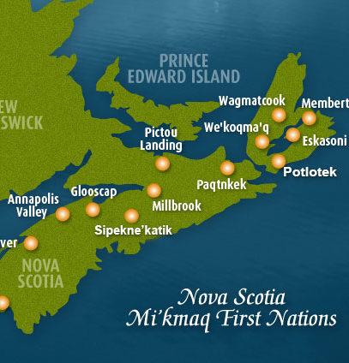
Land
Acknowledgement
I would like to begin by acknowledging that we are in Mi’kma’ki, the ancestral and unceded territory of the Mi’kmaq People. HRM 4Pad sits in Kjipuktuk on the Traditional Territory of the Mi’kmaq. We are all Treaty people.

Slide 3
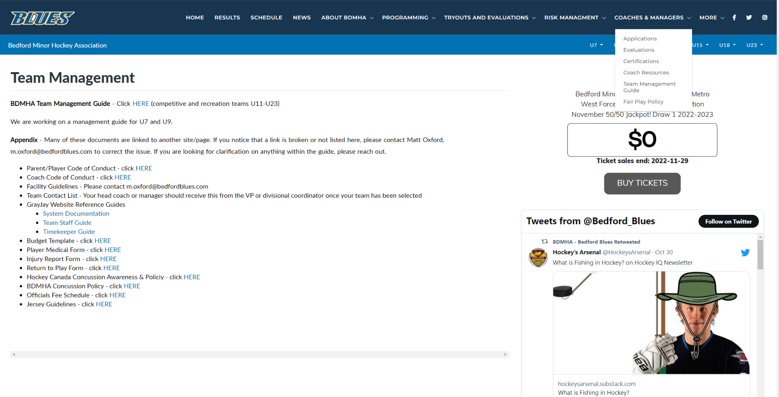
Information and resources for Coaches and Management can be found on the BDMHA website under Coaches and Managers Menu
Website Info
https://bedfordblues.com/l/31/BDMHA/pages/3358/Team-Management/

Slide 4

Drill creation software for all head coaches
We will schedule webinar to go over questions and how to set up group sharing at each level
Collaboration at all levels as we want to encourage sharing of practice plans, drills with coaches
Coaching Resources

Slide 5
Classroom presentations and On-ice presentations
Subject theory;
video clips and
drills with explanations
Various topics to include:
Power Skating
Angling & Battles
Passing & Power Play habits
Defensive Zone and Penalty Kill
BDMHA Coach Development Sessions

Slide 6
Coaching Aids (on ice props/equipment)
Sign-out sheet at Front Desk process
Practice Plan Binders
Please reach out if anyone has questions, needs help on the ice, etc.
Dressing Room #10

Slide 7
4 stations per session - Fundamental skills that can be used in games.
Power skating
3 Skill stations
Plan
1st half of season - Sessions will have hockey staff running stations with coaches on ice getting comfortable with drill
2nd half of season - Skill stations will be run by team coaches with hockey staff providing support/feedback
Core Skills

Slide 8
Intent is to protect players from bullying, harassment and abuse
Supervision required before, during and after all games and practices
“Two Deep Method”
  A lone personnel member should never be in the dressing room with players at any time, especially when players are showering or changing: two adults should be present together
  Supervising personnel must be members of the team staff or adults who have completed either “Speak Out” or the “Respect In Sport” for volunteers and have submitted their record checks [VSC & CRC] to their MHA
  Parents of all players should be made aware of the “Two Deep Method” and avoid letting their children into unsupervised dressing rooms.
“2 Deep Rule”
Failure to comply with this policy will mean:
  1st offense, no penalty but a written warning to the coaches and support staff
  2nd offense, 1 game suspension of head coach
  3rd offense, 3 game suspension of head coach
  4th offense, 5 game suspension of head coach
  5th offense, removed from the roster for the remainder of the season, including playoffs.

Slide 9
Green Armbands
All officials below the age of 18 will wear one green armband on their left arm during all games to identify these officials as minors to team officials, spectators, and parents.
Education campaign to promote initiative and raise awareness about harassment and abuse of officials across HNS.
See HNS Green Armband Presentation

Slide 10
As an organization we believe we should strive to win as a complete team, everyone matters/contributes.
To the best of their ability, a Coach must assume responsibility for affording each player an opportunity to participate fairly and equally, regardless of the player’s ability.
Exceptions:
A player may be benched of all or part of a game at the discretion of the Coach for disciplinary reasons,
  For abusive or foul language directed at players, officials or spectators
  For all actions which are deemed to be detrimental to the welfare of the team. The reason for the benching must be clearly communicated to the player and where appropriate discussed with the player’s parents.
A Coach may assume responsibility for unequal ice time in the final period of a game in a situation where a loss in that crucial game would significantly affect the opportunity for the team to participate in further competitions.
Fair Play
We want coaches and mangers that support this vision!

Slide 11
Your 2022 Divisional Coordinators are:
Division
U11 Jen MacKay j.mackay@bedfordblues.com
U13 Anthony Dopp a.dopp@bedfordblues.com
U15 Ken Lenihan k.lenihan@bedfordblues.com
U18 Trina Canavan t.canavan@bedfordblues.com
Divisional Coordinators 2022

Slide 12
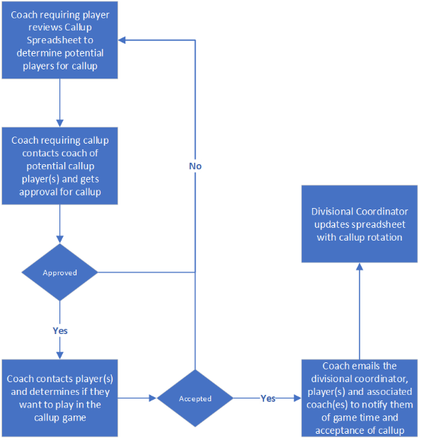
Work with you Divisional Coordinators with regards to the AP process.
For CMHL the basic rules are:
Maximum of 3 AP players per game
A skater may be called up a maximum of 10 times in a season
Can only AP players up to maximum roster size
AP- CMHL

Slide 13
Work with you Divisional Coordinators with regards to the AP process.
For MMHL the basic rules are:
Maximum of 3 AP players per game
A skater may be called up a maximum of 10 times in a season
Can only AP players to a maximum of 10 skaters and 1 Goaltender
AP- MMHL

Slide 14
Social Media Coordinator – Vacant
Follow along on all of our social media accounts:
Facebook
https://www.facebook.com/BDMHA/
Twitter
https://twitter.com/Bedford_Blues
Instagram
https://www.instagram.com/bedfordblues/
Each team will have a twitter account provided by BDMHA
Please send all photos/videos to our social media coordinator at bdmha.socialmedia@gmail.com
Social Media

Slide 15

Questions

